Slide 1
Zoe - Take Home Task
Zsolt Nyiri
2023-08-27

Slide 2
Table of Contents
Data sources & tools used
Data inspection, quality check and added features
Creating the staging-, dimension and derived fact tables
What are the most popular start and end stations?
Is there a relationship between the number of docks and the number of bicycles hired?
Are there any stations that should be expanded based on high usage?
Commuting Patterns
Rental duration analysis
Most common times of day and days of week for bicycle hire (+ monthly trends)
London weather data analysis

Slide 3
Data sources & tools used
Datasource:
London Bicycles Dataset
Contains 2 table:
bigquery-public-data.london_bicycles.cycle_stations
station lookup table with 795 unique stations installed between 2010-06-19 and 2022-10-17
bigquery-public-data.london_bicycles.cycle_hire
ride level data between 2015-01-04 and 2023-01-15
Additional 3rd party data sources:
London weather data
London Geo map
Tools and tech used:
BigQuery
Google Collab (python)

Slide 4
2. Data inspection, quality check and added features
Multiple corrections and improvements were made in order to improve the quality of the datasets. A few examples:
The ride durations had negative values
after a through inspection they were all found to be only present on the last Sunday of October (in multiple years) for ride that started between 1 and 2 am and ended after 2 am
This happens to coincide with the clock shift, so I fixed these
Many stations had a missing station_id between 2016-08-31 and 2016-09-06 that was stored in a different field in this interval, which I backfilled into the original column
Many station had a change of its name or station_id, which I rolled up to have a unique name and id that matched the stations dataset
Many new features were also created for to future analysis. A few examples:
Is the bike electric?
Did the ride happen on a weekend?
In what season?
Etc.

Slide 5
3. Creating the staging-, dimension and derived fact tables
These along with all the fixes were stored in staging tables:
stg_cycle_stations
stg_cycle_hire
These staging tables were then used to create a combined source of truth table:
dim_cycle_data
Also created a lookup table for later use storing all the station properties with the cleaned up ids and named:
dim_cycle_stations
Lastly, 2 derived fact tables were created that stored all the previous data but was rolled up to an hourly level for the analysis:
drv_fact_cycle_data
drv_fact_cycle_hire_weather_combined

Slide 6
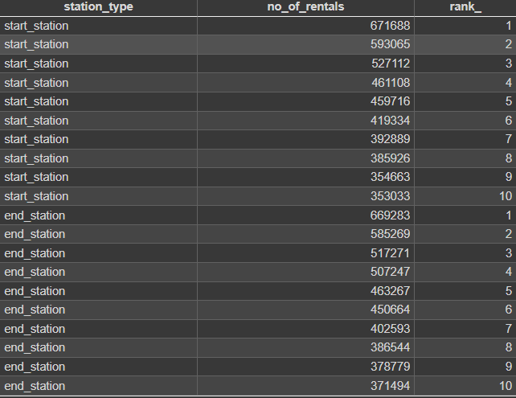
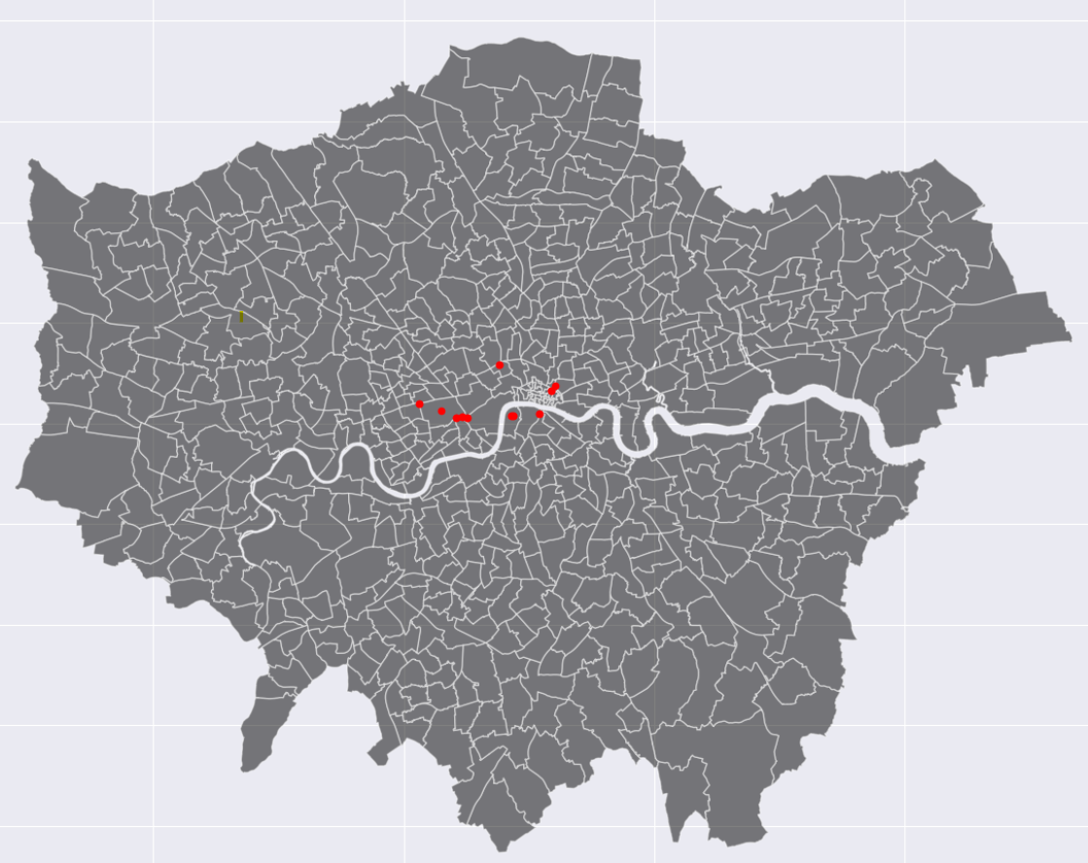
4. What are the most popular start and end stations?
9 out of the 10 most popular start stations are also in the most popular end stations
The 10 most popular start stations make up for the 5.5% of the total traffic
They are centered downtown (London City, Westminster etc. - which suggest the daily commute to work was the most influential factor

Slide 7
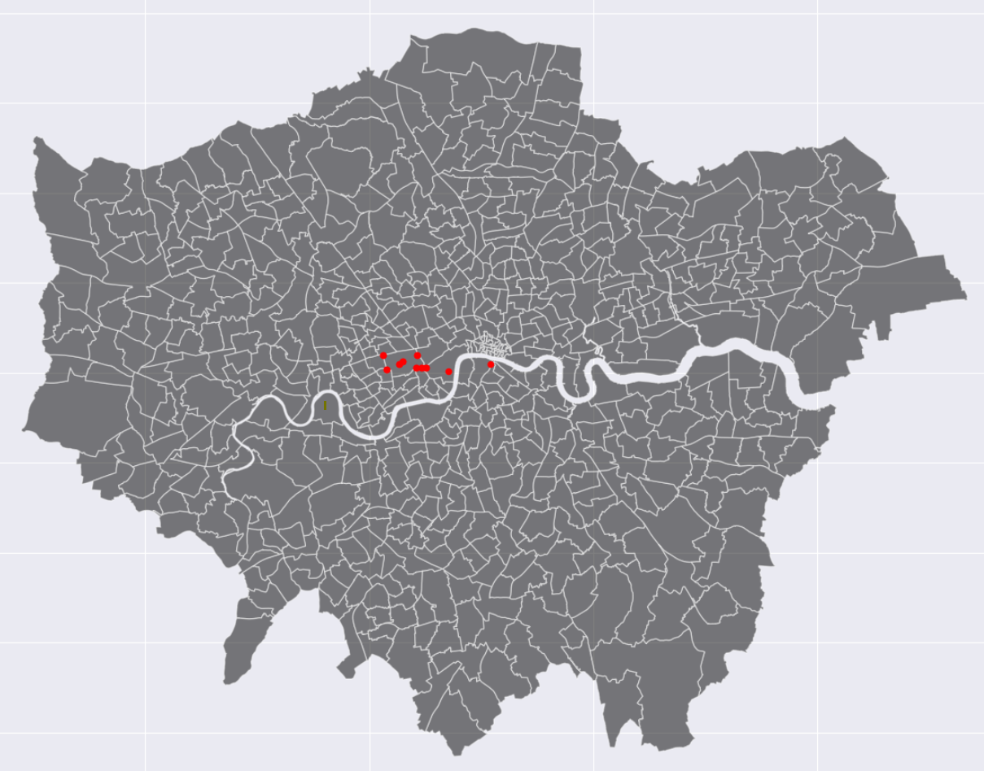
4. What are the most popular start and end stations?
However, if we only focus on the weekend rides, it’s clear that they almost all of the most popular stations are centered around Hyde park which suggest recreational purposes

Slide 8
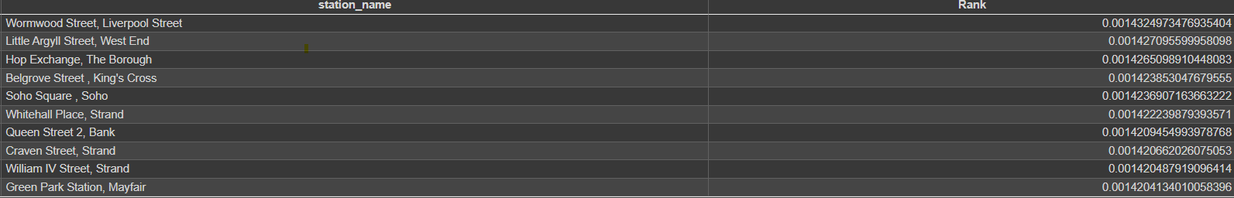
4. What are the most popular start and end stations?
A different way of looking at popularity is by calculating the PageRank for each station
PageRank is a network ranking method (primarily known by the fact that Google is also using it to rank the search results that users see)
It factors in many different features, not just purely the number of traffic (or journeys in this case)
For example, how many connections each station has, and how influential are those connections in the graph
The results are somewhat different to the ranking based on frequency alone, although there is overlap. Would be an interesting next step to understand the differences and what they might suggest

Slide 9
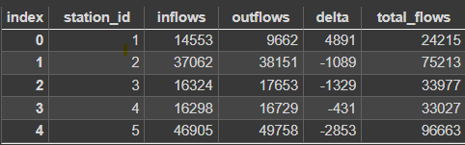
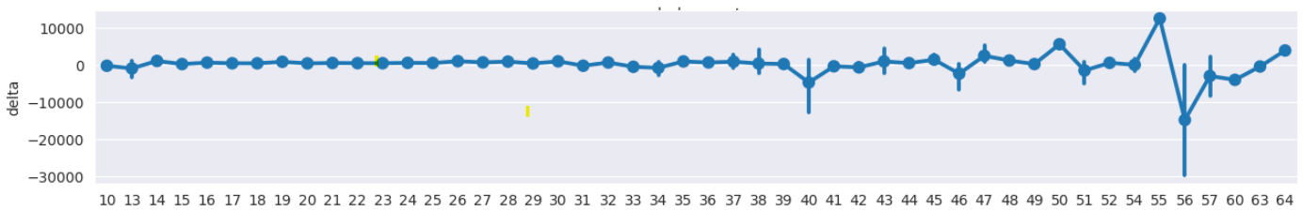
5. Is there a relationship between the number of docks and the number of bicycles hired?
A different way of looking at how much a station is utilised is by attributing the inflow and outflow numbers, and also by looking at the delta of these two (aka. inflow - outflow).
For example:
If we look at the relationship between the delta of the stations and the number of docks, the correlation is not deterministic and crystal clear, but we can see that the biggest delta differences are the ones found at the higher end of the number of docks

Slide 10
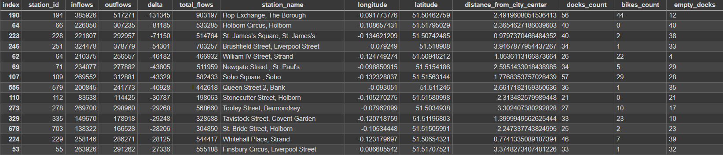
6. Are there any stations that should be expanded based on high usage?
The higher the previously mentioned delta for a station is, the more dock a station needs.
If the delta is a high negative, it means that way more bike is leaving the station that what comes in. These stations need to be stocked up at the start of the day so they don’t run out of bikes too quick and cause frustration to the user. Just to mention a few examples:
Some of the stations on this list (like William IV Street, Strand) has only 26 docks, while it’s a very popular station (high total flows) and a massive negative delta.
For Holborn Circus the number of docks is fairly high (although should still be higher), and the 0 bikes_count is also worrying if it implies that they are all taken, as it’s an outflow station.

Slide 11
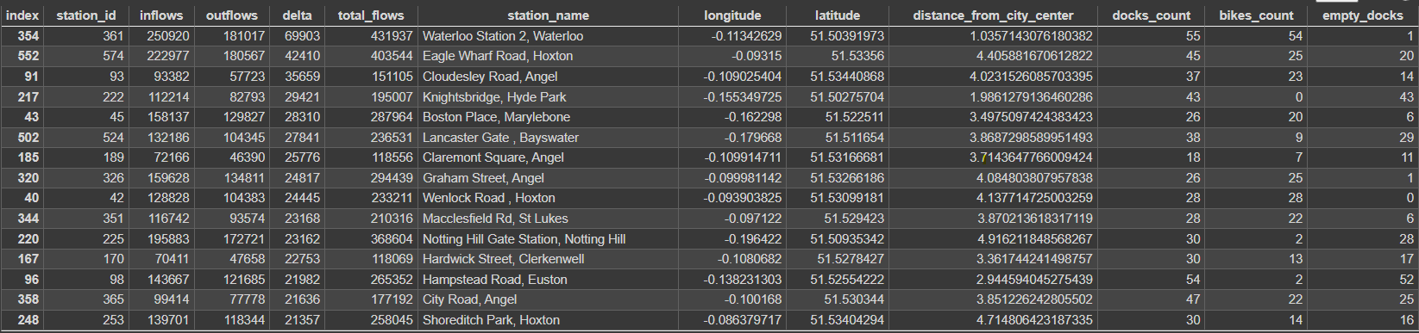
6. Are there any stations that should be expanded based on high usage?
Looking at the other way around (high positive delta), we can also see room for improvement (docks count should be very high, bikes count should be low):
Waterloo station, even though has a high docks count, has only 1 empty dock - which suggest that people won’t be able to park their bikes there as it’s often full, being the highest positive delta station
Other stations (like Graham Street or Wenlock Road) also follows this pattern, with the additional vulnerability that they also have a low dock count

Slide 12
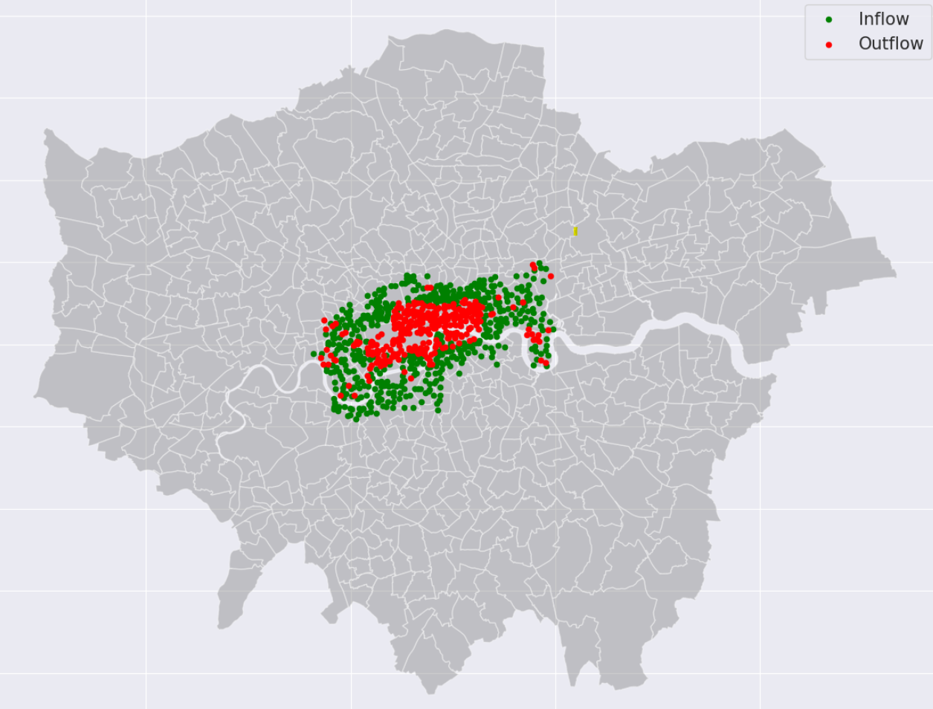
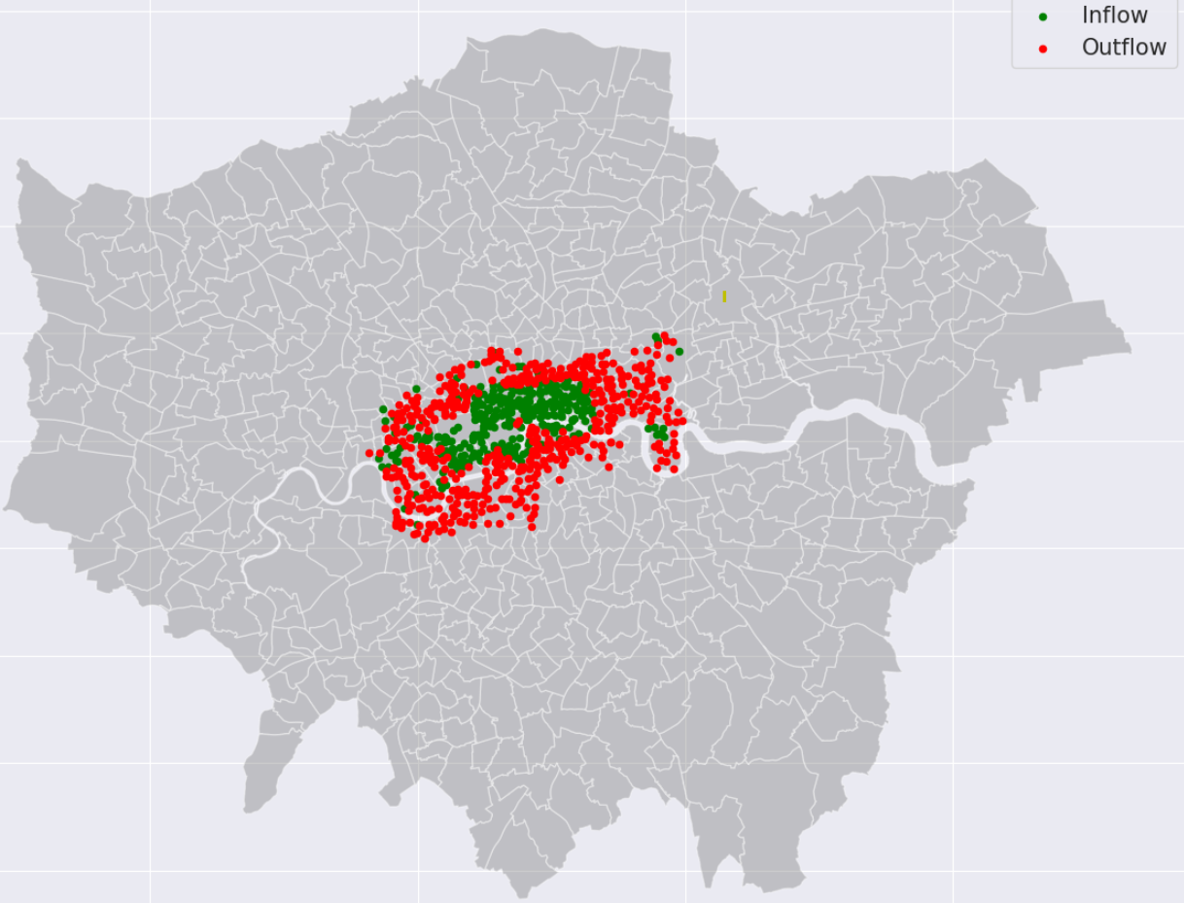
7. Commuting Patterns
If we divide the dataset into 2 parts:
Rides between 7 and 10 in morning on weekdays
Rides between 17 and 20 in the evening on weekdays
We can assign every station a flag based on the previously calculated delta values (negative = outflow, positive = inflow) The commuting pattern of Londoners is clearly visible on this view, and this could be used to further optimise bike counts at different stations based on the hours.
Mornings
Evenings

Slide 13
8. Rental duration analysis
During the inspection of the base cycle_hire_source table it became apparent that there are some anomalies there which worth looking into.
There are 27546 rides that exceed the legal maximum of 24 hours in duration, the highest being 94025 minutes (!)
Even though this is only 0.03% of all the rides, there is indication that people are doing it so there might be a potential market for long term bike renting
This would be worth investigating either as a separate product, or just somehow incorporate into the current business model
The negative durations anomaly was already covered earlier
There are also 19518 cases where the end station id is completely missing, hence these rides don’t have durations nor end times
This indicates that either there are bugs in the tracking system - if so this should be investigated
Or these bikes were never returned (stolen?) - if so this should be tracked and the security measures should be revised in order to minimise these numbers

Slide 14
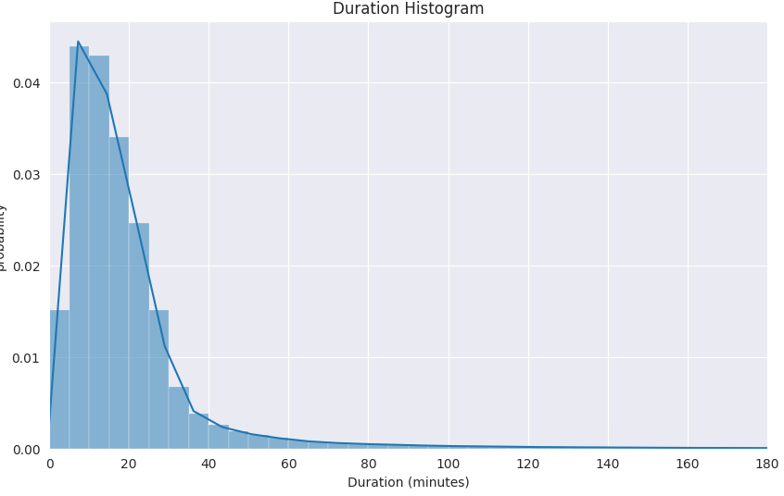
8. Rental duration analysis
The avg. duration of a ride is ~1308 seconds, meanwhile the mode is only 840
This indicates a very tilted distribution (probably due to the enormous outliers)
Looking at the distribution of the durations we can get a clearer picture of the actual rides
As expected the distribution tilts heavily to the left.
Short (less than 5 mins) rides are as common as 25-30 min rides.
The majority of the rides being between 0-40 mins.
Longer rides than 90 mins are very unlikely

Slide 15
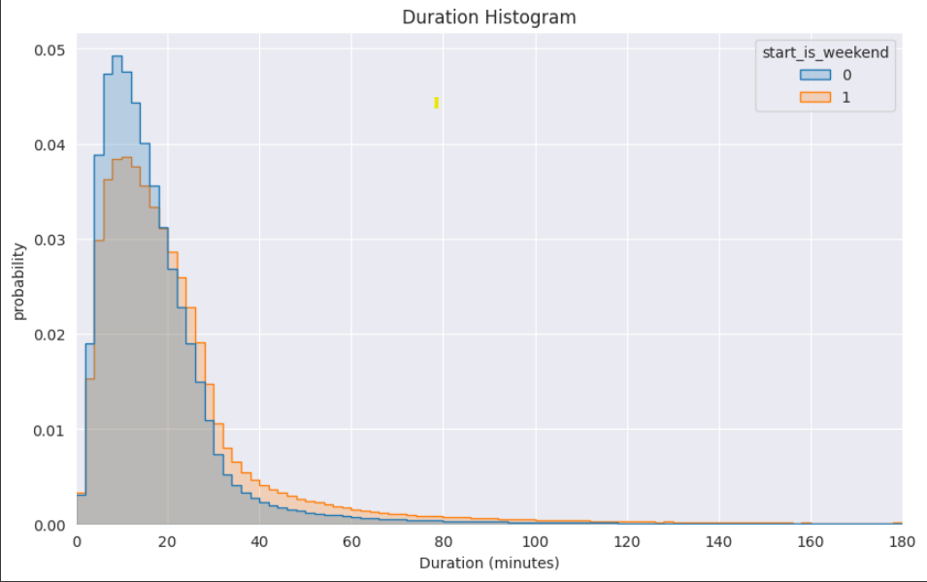
8. Rental duration analysis
Looking at the same distribution split by weekday and weekend usage, we can establish that even though there are less rides on weekends, these tend to be somewhat longer.
The distribution decreases less sharply and the tail is higher longer
For example 40 minutes leisure rides are almost twice as likely on a weekend

Slide 16
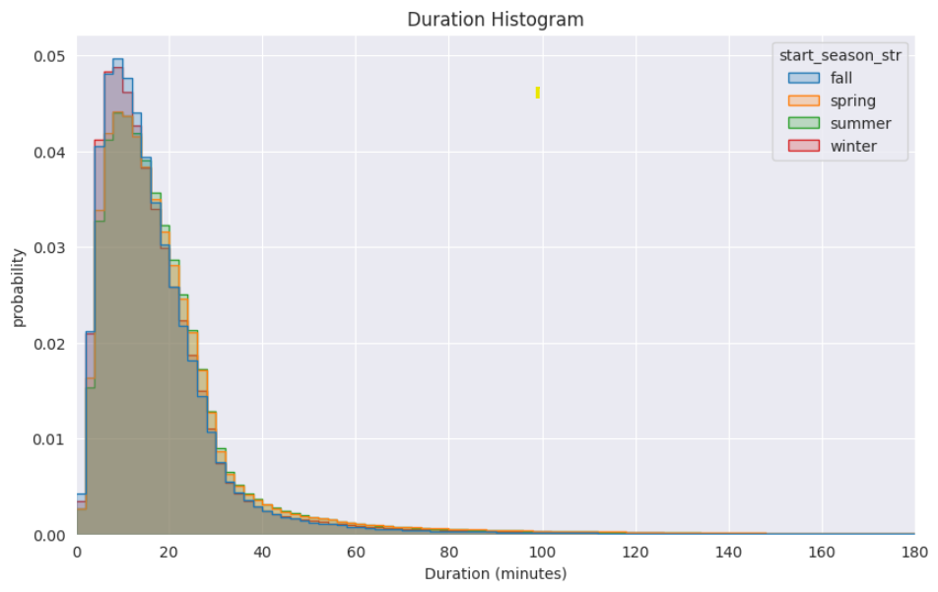
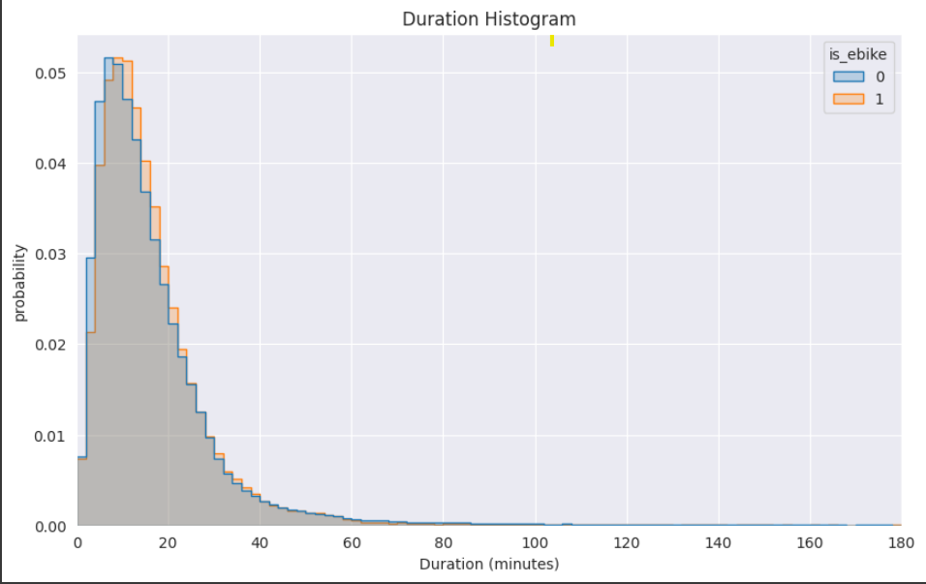
8. Rental duration analysis
The seasonal effect is similar to the electric bike one:
People tend ride 2-4 mins longer in the sprint and during the summer
Electric bikes have less of an effect on the tail, the distribution is very much the same, but shifted ~4 minutes to the longer side

Slide 17
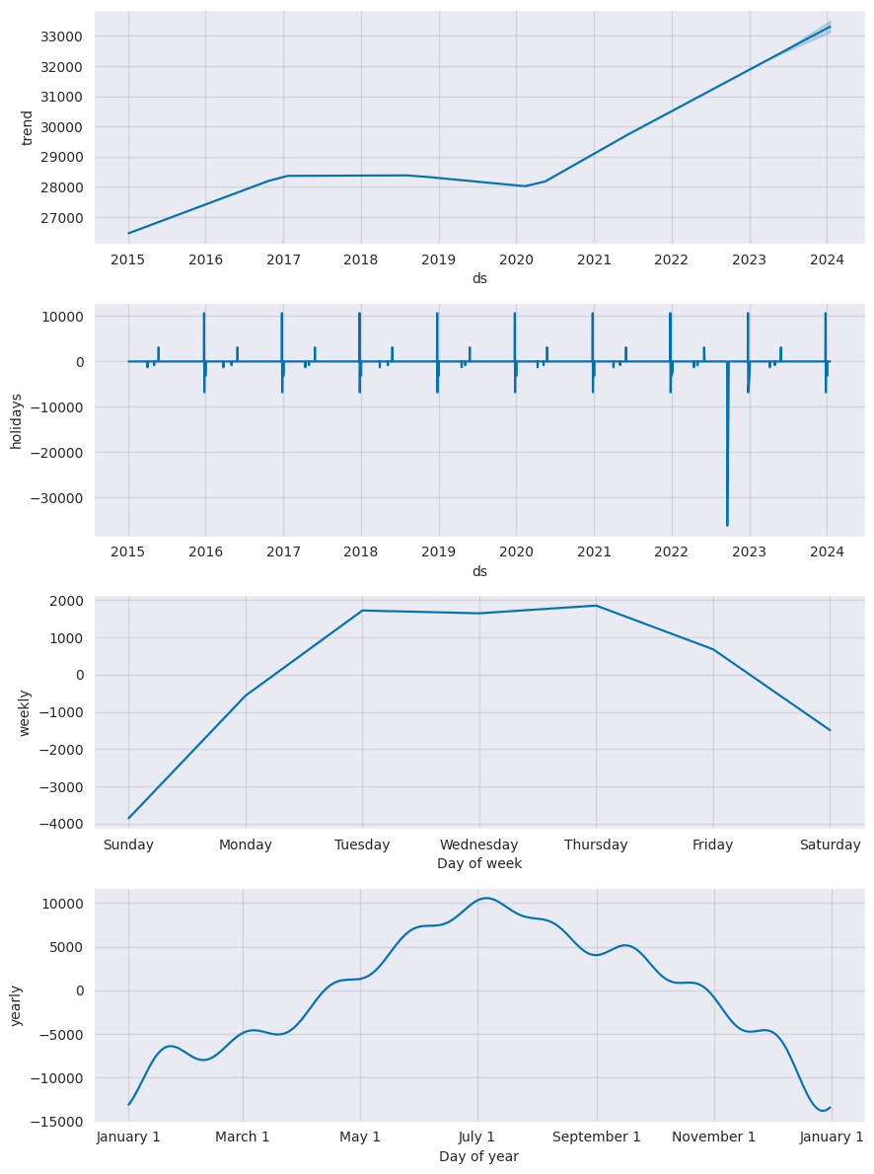
9-10. Most common times of day and days of week for bicycle hire (+ monthly trends)
For the trend and seasonality analysis I used Facebook’s Prophet algorithm. I created two different models:
Daily model (aggregated on a daily level)
Hourly model (aggregated on an hourly level)
Looking at the Daily model first, there are multiple learnings:
There was an upwards going trend from 2015 to 2017, which then stagnated (and even slightly decreased) until Covid hit in the number of rentals. However, since Covid it picked up an enormous steam and trending massive upwards since
Based on the predication this trend is bound to continue in 2023-2024 as well.
The bank and national holidays have varying effect. On some usage increases, while on others it decreases.
On one very visible outlier in late 2022 the bank holiday caused a massive decrease. Looking into the data it was the Queen’s funeral.
Bike usage is the lowest during the weekend, gradually increasing until Tuesday where it peaks until Thursday after which it decreases again
The monthly seasonality is crystal clear also
January being the lowest month, then (although with some bumps) usage increases until July, after which it starts dropping again

Slide 18
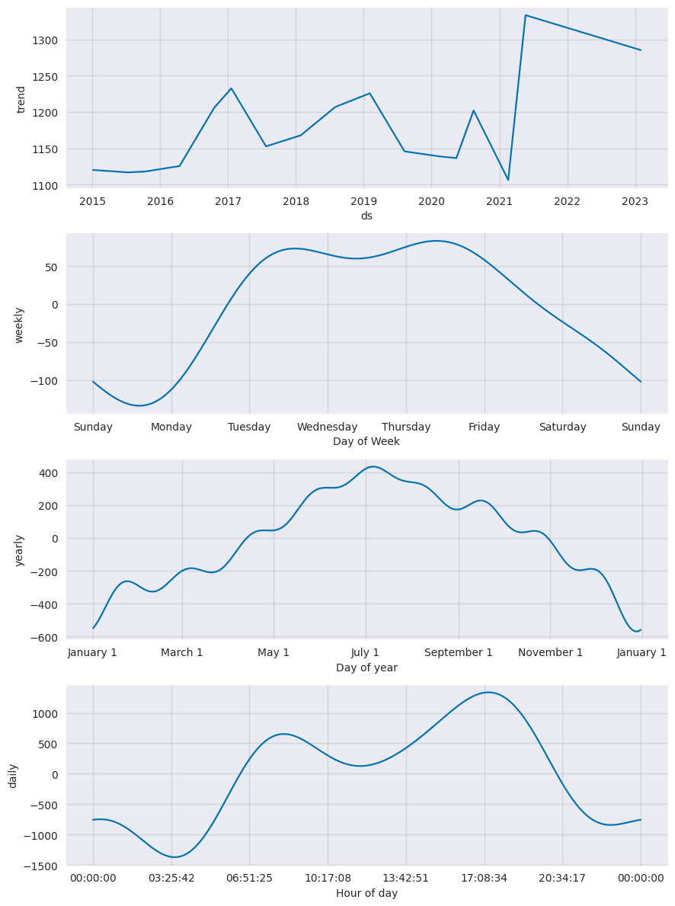
9-10. Most common times of day and days of week for bicycle hire (+ monthly trends)
Looking at the hourly model, it’s much of the same (although the curves are more detailed), except for added information of the daily seasonality.
Generally usage starts picking up around 4am until 9-9:30 in the morning (most likely due to the morning commute)
Then slightly decreases during the day
Just to pick up again and reaching a second mode around 5pm (after work commute)
Then gradually decreases until the next morning, only having a very small bump around midnight (pub commute?)

Slide 19
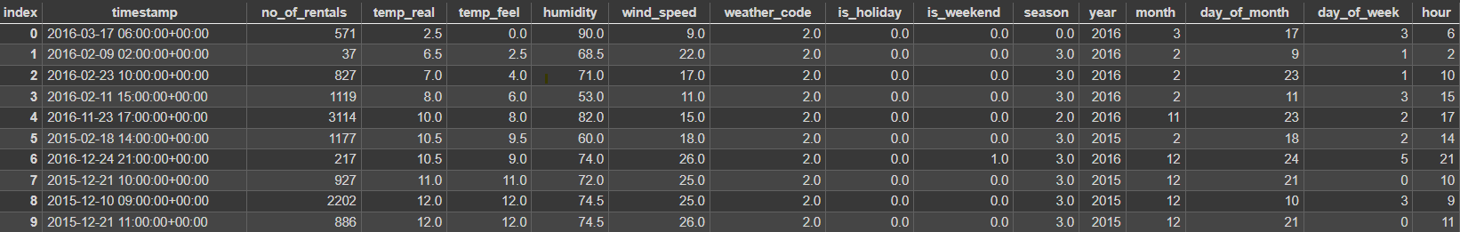
11. London weather data analysis
For the weather analysis I use the previously mentioned drv_fact_cycle_hire_weather_combined table which is a 3rd party hourly weather data combined with the given usage data, plus additional date features that I created.

Slide 20
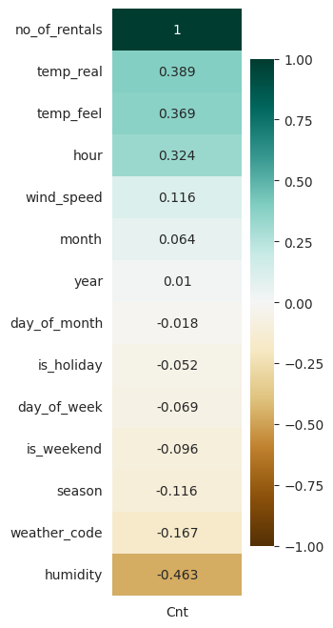
11. London weather data analysis
After checking for multicollinearity which signals no multicollinearity problem, we can see a few interesting correlations.
The number of rentals seem to correlate positively with the temperature and the hour and correlate negatively with humidity.

Slide 21
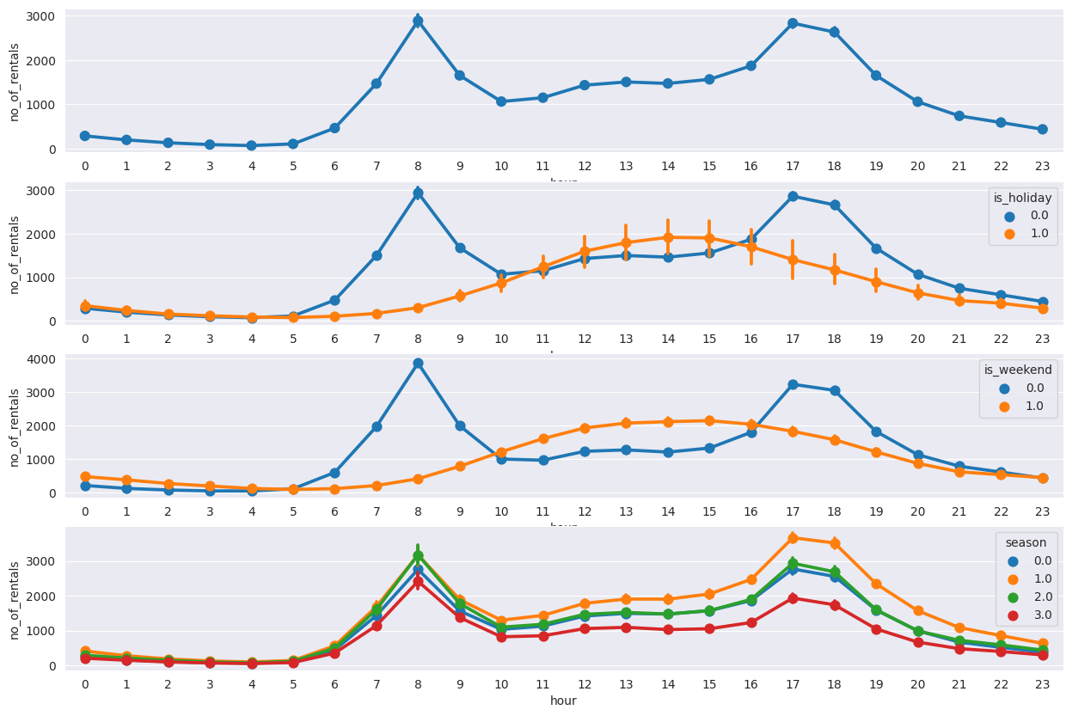
11. London weather data analysis
Looking at rentals with the hours on the X axis we can deduct several trend:
As previously seen, the number of rentals has a bimodal distribution during the day (peak around 8am and 5-6pm
If we split this by holidays, the trend changes, turning into a single modal and flatter distribution
The weekends are very similar to the holidays.
Regarding the seasons, Summer has the highest usage in general, specially late afternoon, Sprint and Fall being the in the middle, with Winter lagging way behind

